Slide 1
Inventory Management System: Semester 1 Demo
By:
David Erickson
August Davis
Christian Hansen

Slide 2
Our goals
Create an inventory system application that:
Can scan the barcodes located on all department equipment
Makes accessing and modifying inventory data easy for the user
Protects the inventory data from unauthorized actions
Runs on android
Document the project in a way that will allow others to easily modify the project at a later date

Slide 3
The Road so far
We have broken the project in to three parts:
The backend database
How to scan the barcodes in to the application
The main UI

Slide 4
Progress on database
Microsoft SQL Server is still the current plan for database software
We know where we will host it: we have permission to host it on the department’s servers.
Waiting on confirmation from the department before we are able to have access
We have all of our data fields mapped out
A test database will be used to store and test data until we are able to gain server access

Slide 5
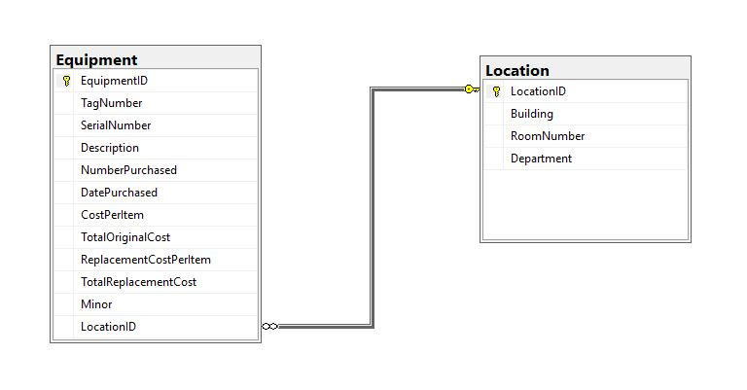
Database Diagram

Slide 6
Progress on barcode scanning
The original plane was to use Google Vision to scan our barcodes, this was a dead end
Plan B is the XZing.Net.Moblie (Zebra crossing) library
Due to an unfamiliarity with the library, C# and Visual Studio we are currently in the experimentation phase of getting this component working and integrated in to the main application UI.

Slide 7
Main Application UI
Demo

Slide 8
The immediate Road ahead: (now – end of the break)
Begin writing stored procedures or queries for inserting, updating, and deleting data
Establish user roles on the database end to ensure only privileged users can manipulate data
Develop a better understanding of Zebra Crossing
Continue to improve the UI prototype
Add more documentation to the project

Slide 9
Further down the road: (next Semester)
Create and deploy our database on campus servers
Write web hooks to connect UI to our database adding the appropriate security measures
Integrate Zebra crossing into our application
Finalize our UI
Package our documentation and Application in a

